Slide 1
Beam dynamics and beam losses in linear accelerators
Doug Curry
USPAS, January 2017
*Mike Plum, USPAS / Joint International Accelerator School Beam Loss and Accelerator Protection
Newport Beach, California Nov. 2014

Slide 2
Overview
Beam loss mechanisms
  Focus on beam loss in linacs
  Continuous beam loss (e.g. beam halo, residual gas, IBSt, …)
  Occasional beam loss (e.g. equipment faults)
  H⁻ vs H⁺ beam loss mechanisms
Beam loss mitigation
  Scraping & collimation
  Equipment modifications (add vacuum pumps, add chicane, …)
  Tuning
  Track down the occasional equipment faults

Slide 3
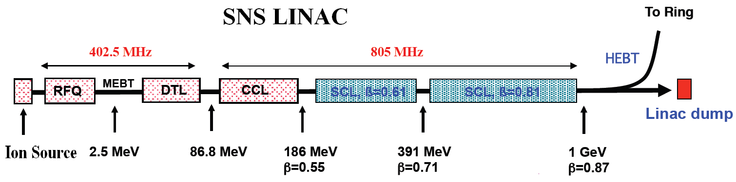
SNS Linac Structure
Proton beam energy on target 1.0 GeV
Proton beam current on target 1.4 mA
Power on target 1.4 MW
Pulse repetition rate 60 Hz
Beam macropulse duty factor 6.0 %
Ring fill time 1.0 ms
Protons per pulse on target 1.5x10¹⁴
Proton pulse width on target 695 ns
Linac length 335 m
Total Beamline Length 903 m

Slide 4
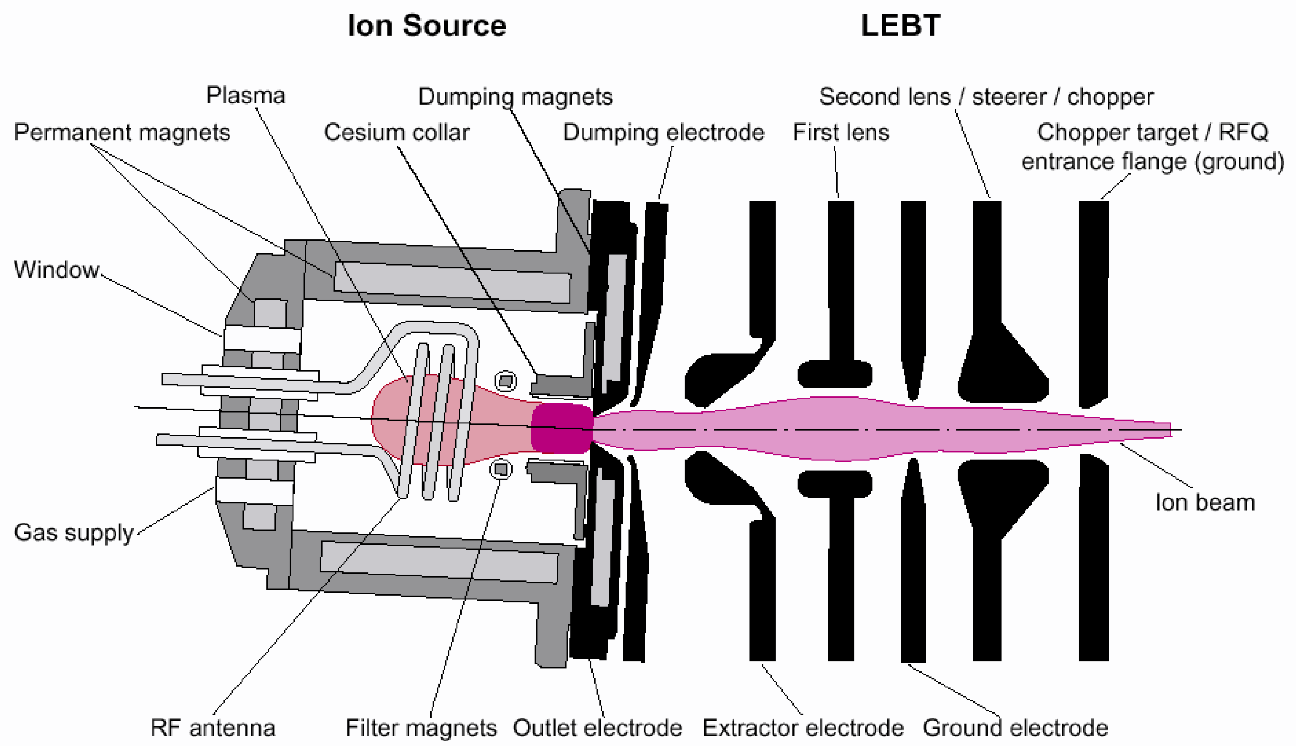
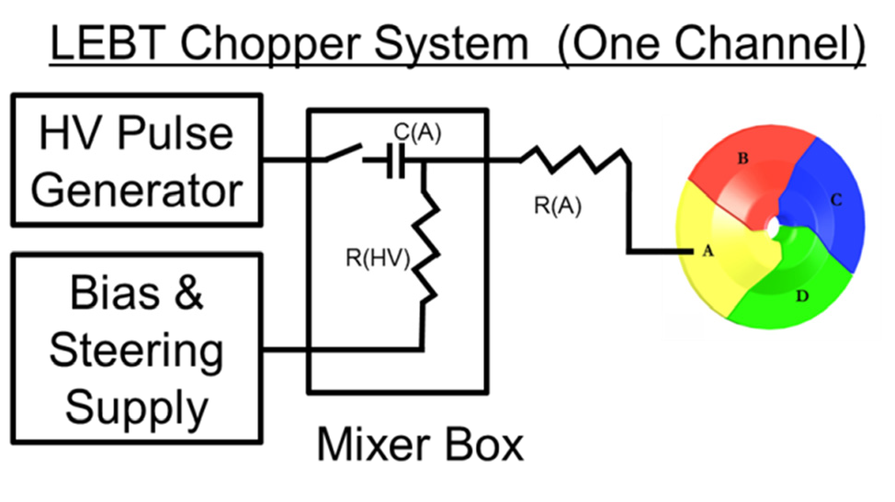




SNS Accelerator Complex
Chopper system makes gaps
mini-pulse
1 ms H- beam

Slide 5
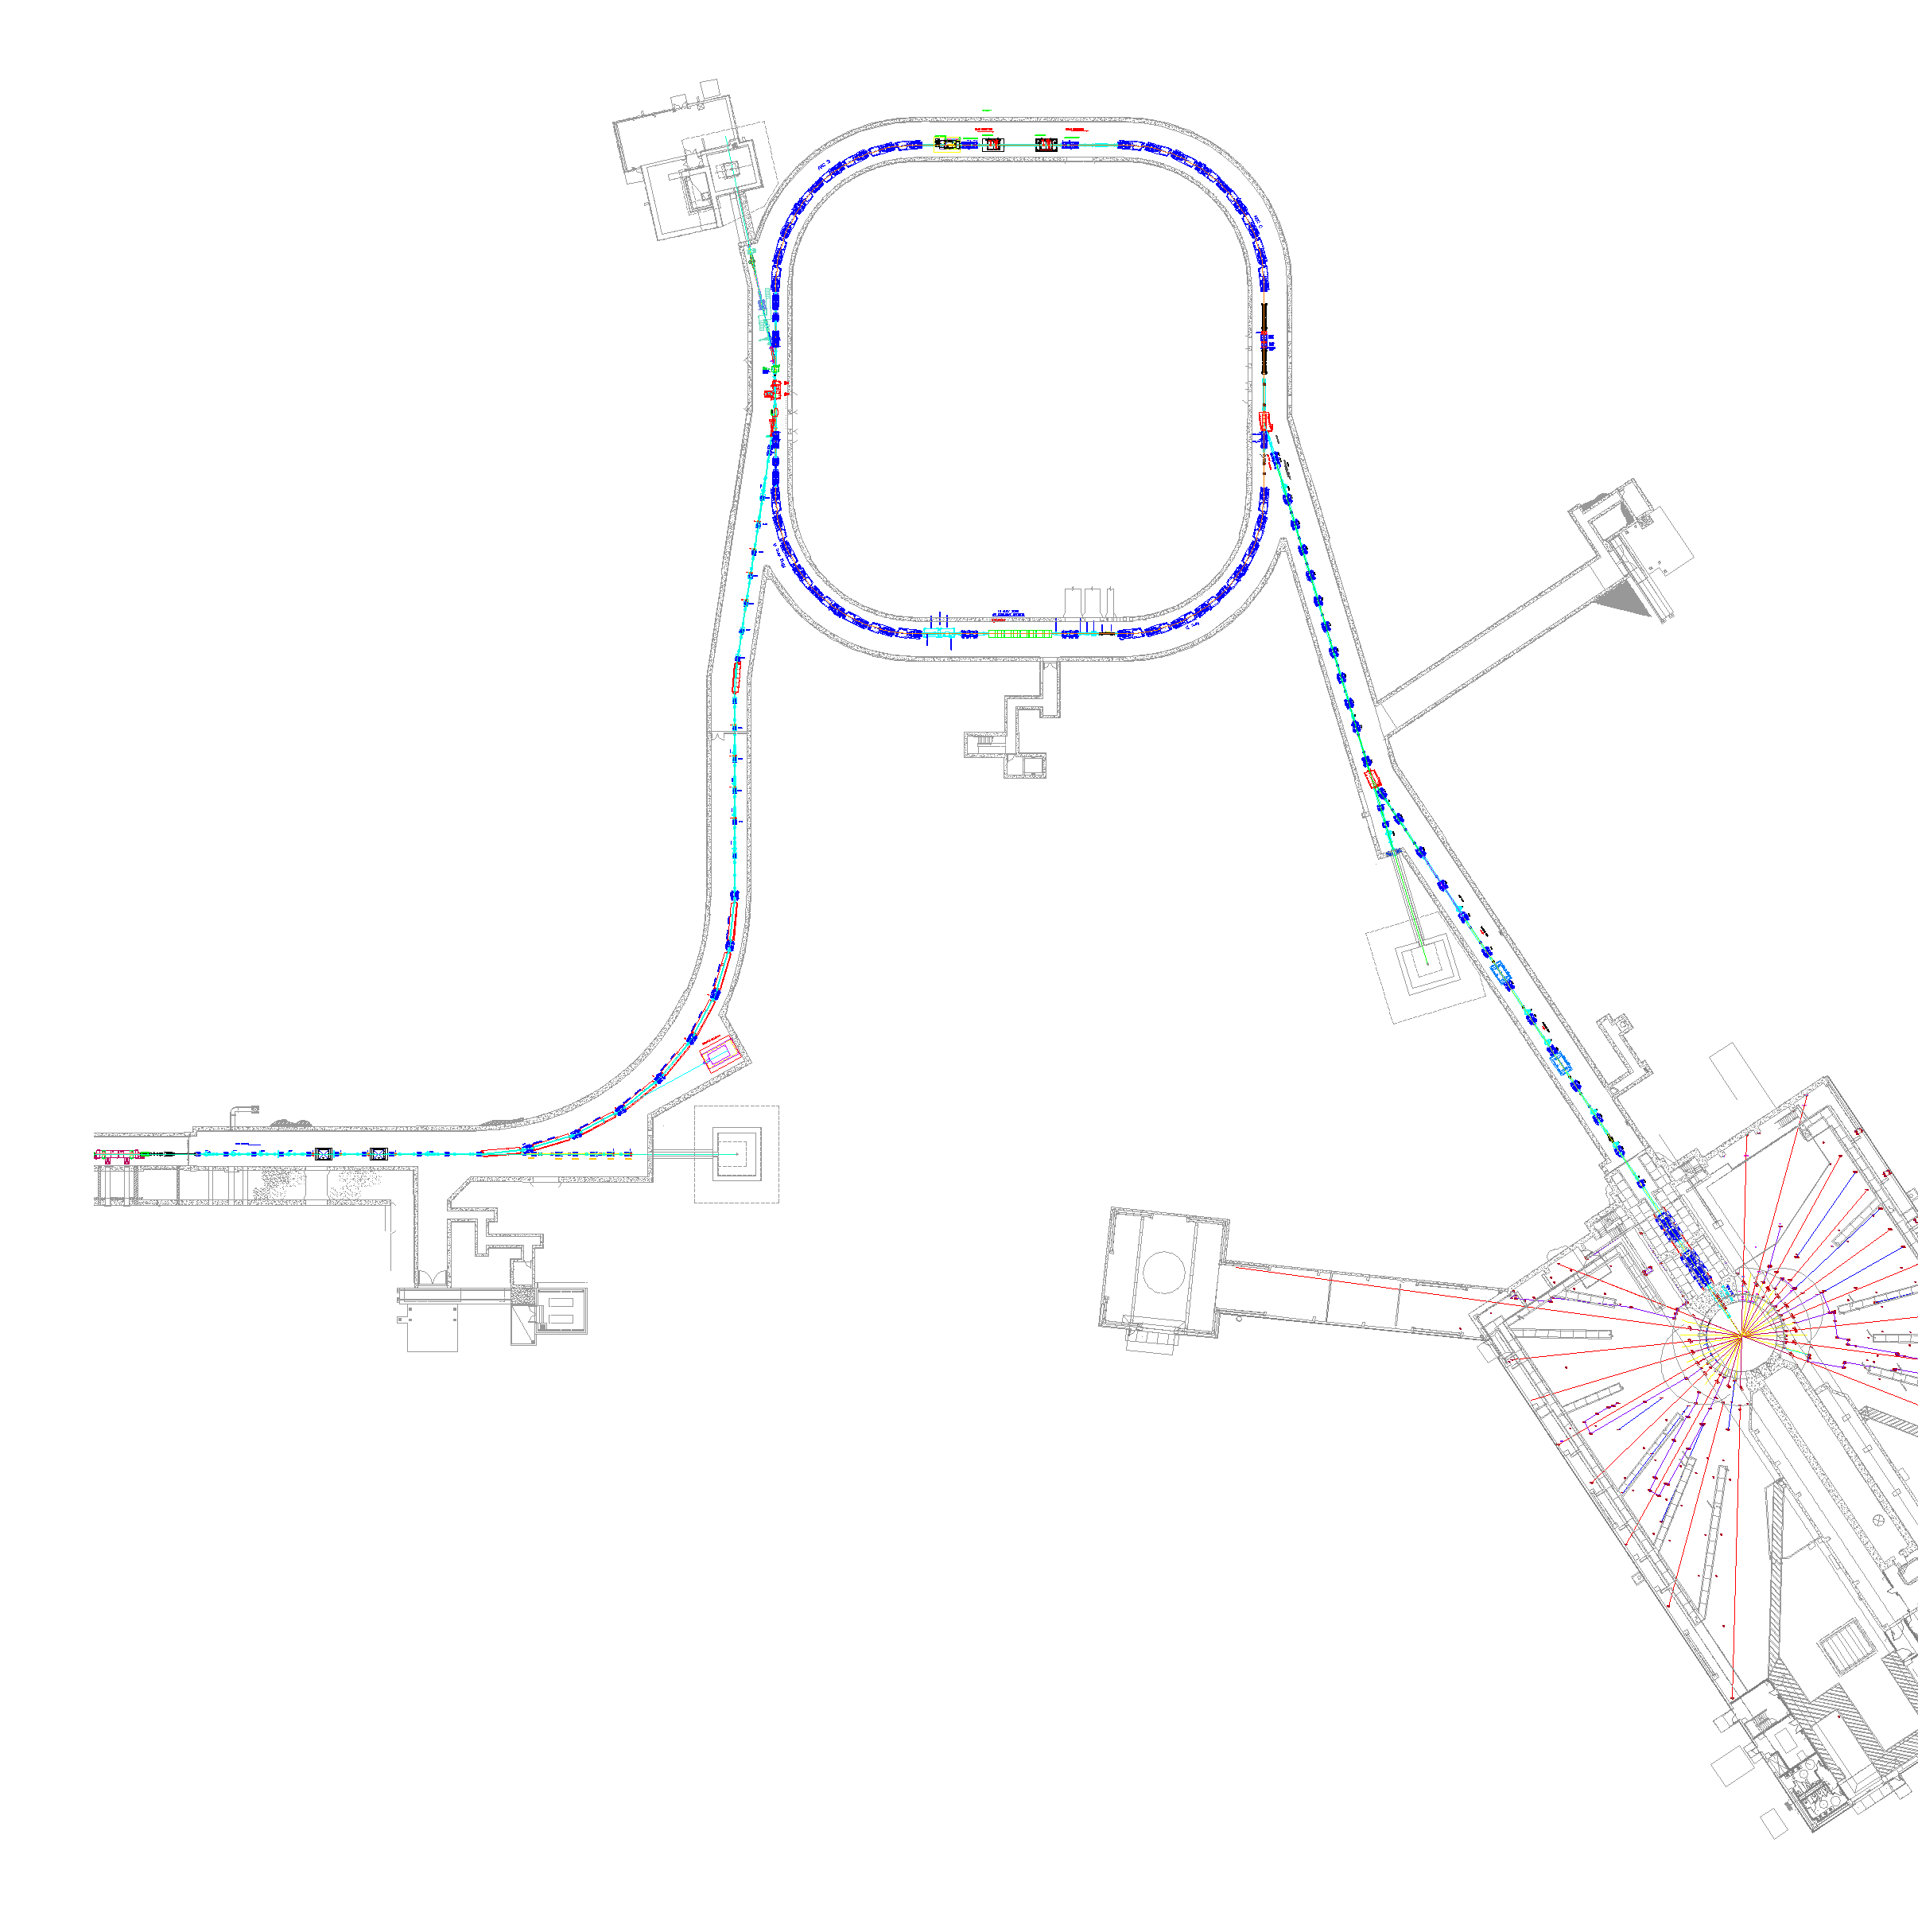


















SNS Accelerator Complex
The SNS machine has over 100,000 control points and cycles ~5.2 million times a day
Accumulator Ring
1000 MeV
Extraction Kickers x14
Front-End:
Produce a 1-msec long, chopped,
H⁻ beam
2.5 MeV
1 GeV LINAC
Injection Kickers x8
Stripper foil H⁻ to H⁺
Front-End
LINAC
Liquid Hg Target
Chopper system makes gaps
Accumulated
Current
mini-pulse
Current
~1000 bunches ~700ns wide

Slide 6
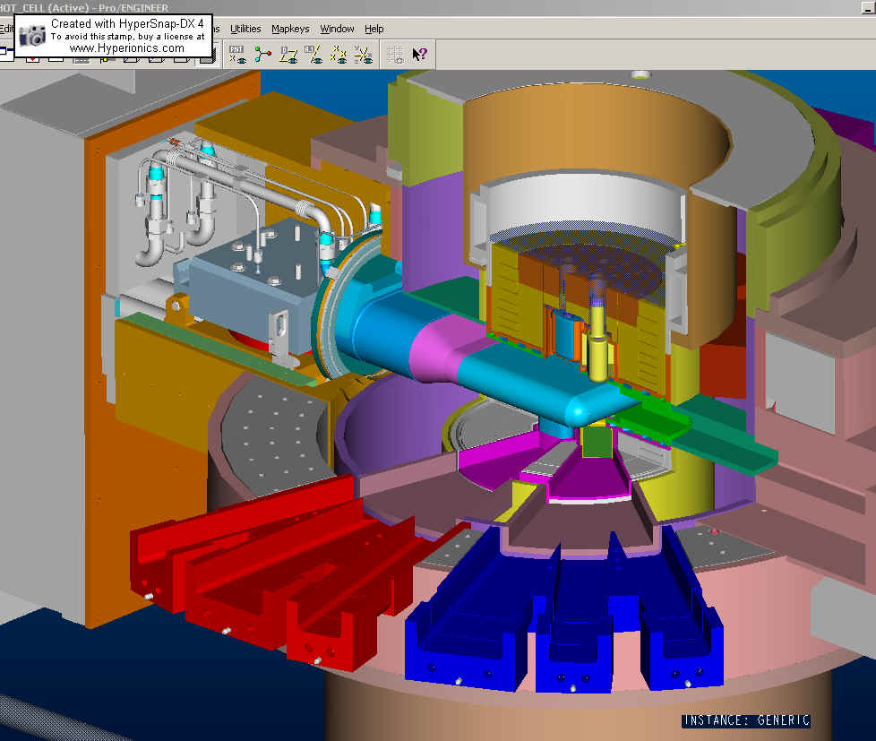
SNS Target Structure
Hg lines
Inner Reflector Plug
Target Module
Outer Reflector Plug
Proton Beam
Core Vessel Multi-channel flange

Slide 7
Why H⁻ beams
Low-loss multiple-turn injection into the same RF bucket in storage rings and synchrotrons requires charge-exchange injection
  Typical beam loss without charge exchange injection is several percent
  Example: SNS Linac beam power is 1.4 MW. If 2% is lost at injection, you are losing 28 kW !!
  Example: SNS ring charge-exchange injection fractional loss is (1 – 2)x10⁻⁴, so power loss is 140 – 240 W
Charge exchange injection also required if want output beam emittance to be less than the sum of the input emittances
To accumulate protons and use charge-exchange injection you must accelerate H⁻ ions

Slide 8
Continuous beam loss
• There are many different and interesting continuous beam loss mechanisms in high-intensity H⁺ and H⁻ linacs
– Residual gas stripping
– Intra-beam stripping
H⁻ only
– H⁺ capture and acceleration
– Field stripping
– Beam halo/tails (resonances, collective effects, mismatch, etc.)
– RF and/or ion source turn on/off transients
– Dark current from ion source

Slide 9
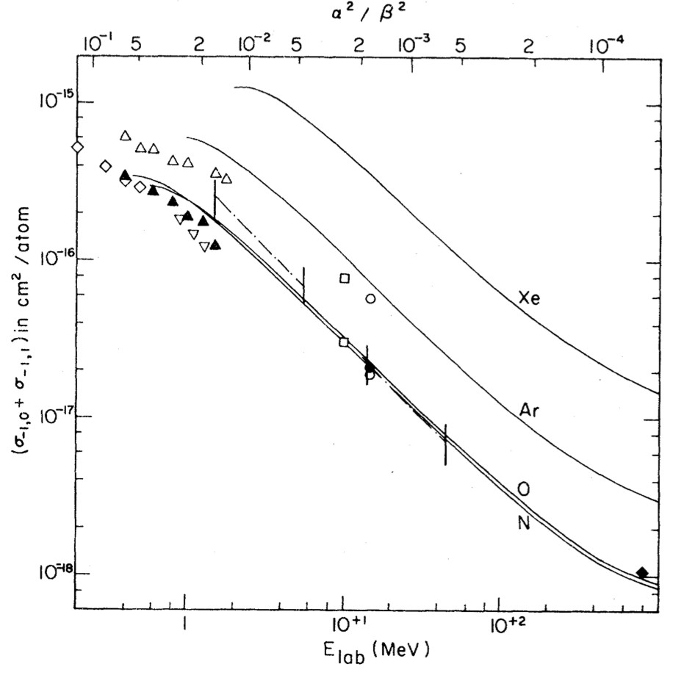


Residual gas stripping
• Beam loss caused by single (H⁻ to H⁰) or double (H⁻ to H⁺) stripping due to interaction with residual gas
• Can occur anywhere in the accelerator, but cross sections are highest at low beam energies
Gas stripping cross section
Cross section for double stripping (H⁻ to H⁺) is about 4% of cross section for single stripping (H⁻ to H⁰)
G. Gillespie, Phys. Rev. A 15 (1977) 563
G. Gillespie, Phys. Rev. A 16 (1977) 943
0.6 to 600 MeV

Slide 10
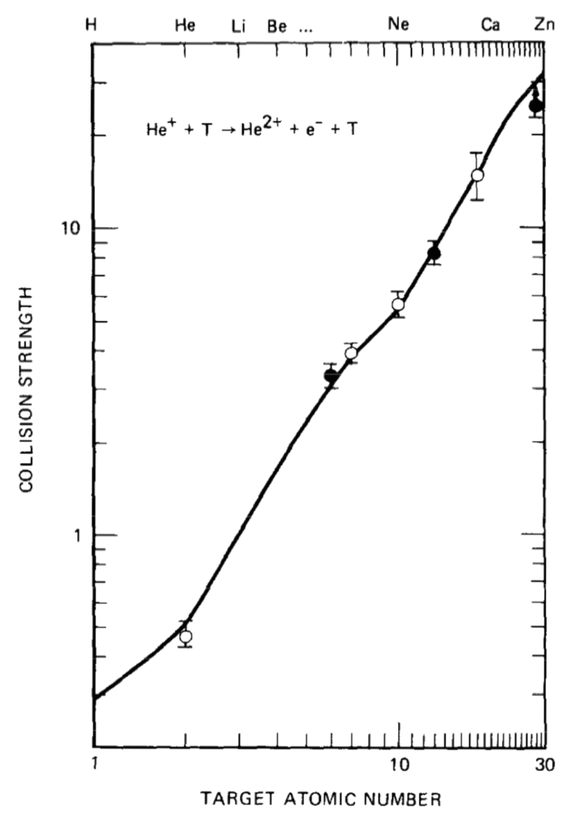
Residual gas stripping (cont.)
Stripping cross sections scale with atomic number
Good news: Typical gas species in an accelerator: mainly H₂ and H₂O, then some CO and CO₂
G. Gillespie, NIM B2 (1984) 231-234.

Slide 11
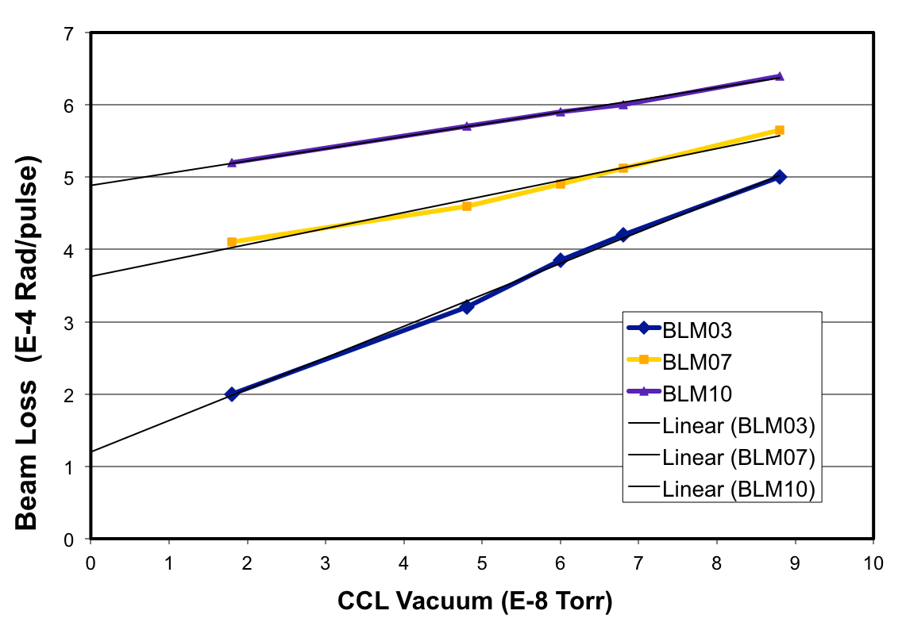
Residual gas stripping (cont.)
Residual gas stripping in SNS CCL
SNS
  Stripping in warm linac causes loss in the SCL
  Hot spot in transport line to ring is likely due to gas stripping
LANSCE
  Measured to cause about 25% of the H⁻ beam loss along linac
BLM10
(Courtesy J. Galambos)
BLM07
BLM03

Slide 12
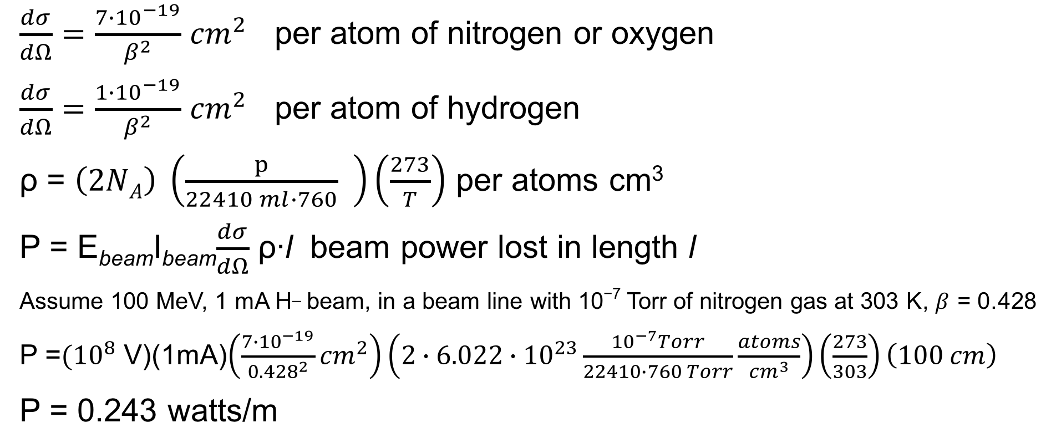
Example: gas stripping calculation
$\frac{dσ}{dΩ}=\frac{{7∙10}^{−19}}{β^{2}}$ ${cm}^{2}$ per atom of nitrogen or oxygen
$\frac{dσ}{dΩ}=\frac{{1∙10}^{−19}}{β^{2}}$ ${cm}^{2}$ per atom of hydrogen
ρ = $\left(2NA\right) \left(\frac{p}{22410 ml∙760} \right)\left(\frac{273}{T}\right)$ per atoms cm³
P = E_{beam}I_{beam}$\frac{dσ}{dΩ}$ ρ∙l beam power lost in length l
Assume 100 MeV, 1 mA H_ beam, in a beam line with 10⁻⁷ Torr of nitrogen gas at 303 K, $β$ = 0.428
P =${(10}^{8}$ V)(1mA)$\left(\frac{{7∙10}^{−19}}{{0.428}^{2}}{cm}^{2}\right)\left({2∙6.022∙10}^{23}\frac{{10}^{−7}Torr}{22410∙760 Torr}\frac{atoms}{{cm}^{3}}\right)\left(\frac{273}{303}\right)\left(100 cm\right)$
P = 0.243 watts/m

Slide 13
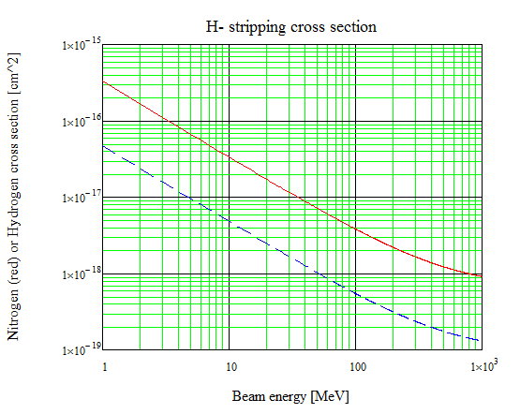
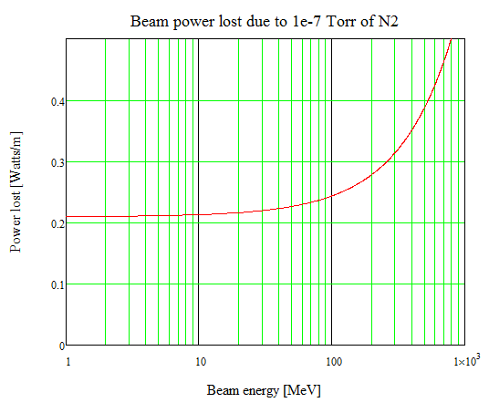
Example: Gas stripping calculation (cont.)
1 mA H⁻ beam
Residual gas stripping causes increasing power loss as beam energy increases

Slide 14
Dose from proton beam loss vs. energy
(at 30 cm after 4 Hours)
Typical limit for hands-on maintenance
100
1 nA / m *
1 Watt / m *
90
80
Dose Rate ( mrem / h)
* assumes dose ~ Cu n yield ~ E^{1.8}
70
60
~0.33(E-9)^{1.8}/E
50
40
30
20
10
0
0
200
400
600
800
1000
1200
Note: 100 mrem/h = 1 mSv/h
Energy (MeV)
(J. Galambos et al., Snowmass, July 7, 2001)
12/54

Slide 15
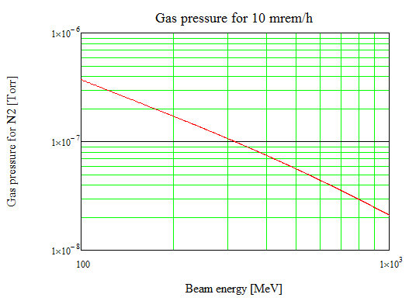
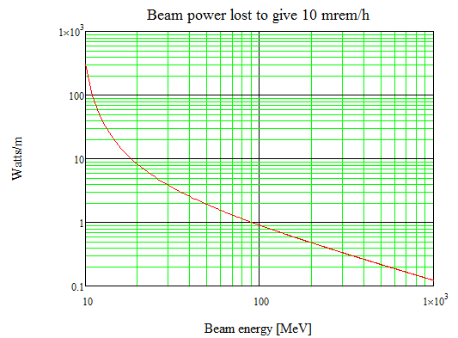
Example: Gas stripping calculation (cont.)
Assume 1 mA H⁻ beam, 10 mrem/h (0.1 mSv/h)
To maintain a constant level of activation caused by residual gas stripping, the allowable gas pressure decreases as the beam energy increases

Slide 16
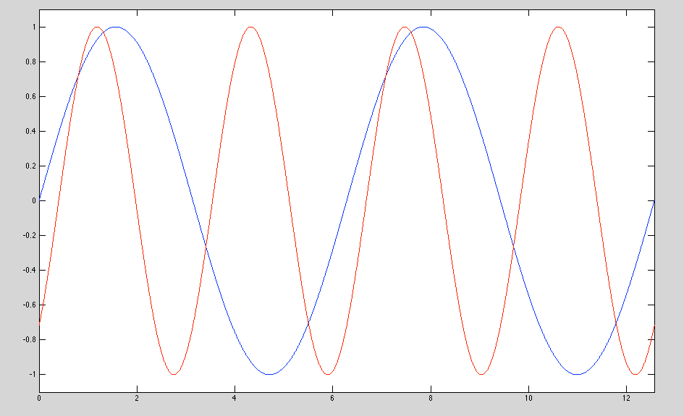
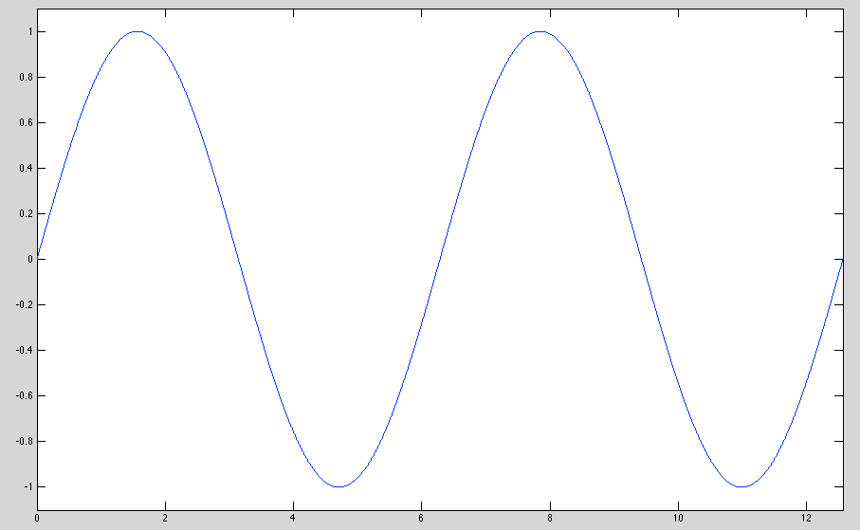
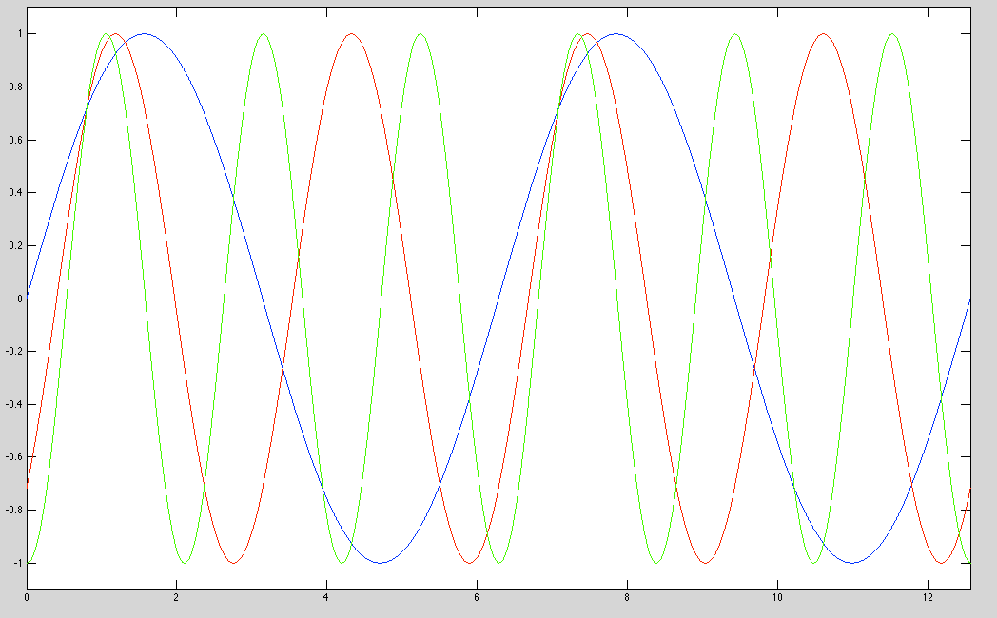
H⁺ capture and acceleration
Due to double-stripping (H⁻ to H⁰ to H⁺) usually at low beam energy (where cross sections are highest and where capture into RF buckets is more likely). H⁺ is captured and accelerated in linac, then lost.
Stopped by even (e.g. 2, 4, etc.) frequency jumps in linac RF
1x
_{H}−
2x3x
_{H}−
Field in cavity
_{H}+
_{H}+
Time

Slide 17
H⁺ capture and acceleration (cont.)
May be present to a small degree in the SNS linac
  See loss at 402.5 to 805 MHz frequency jump, but also expect loss due to the lattice transition. Not a problem for 1 MW operations.
Seen at J-PARC linac
  Entire linac all at same frequency (until energy upgrade in 2013 – 2014, when new 3rd harmonic section was added), so H⁺ was accelerated and transported to the end of the linac, and lost in arc leading to ring
  Cured by adding chicane magnets in MEBT
Seen at LANSCE
  Significant source of beam loss if there is a vacuum leak in the LEBT

Slide 18
Intra-beam stripping at SNS
This is the dominant source of beam loss in the SNS SCL
During the Oak Ridge SNS design phase, the beam loss in the SCL was expected to be negligible
  Beam pipe aperture is about 10 times rms beam size (76 mm), much larger than upstream warm linac (30 mm)
  Vacuum pressure very low due to cryogenic pumping
Found unexpected beam loss and activation during the SNS power ramp up
Found losses much lower for quad gradients reduced by up to 40%. Also found that beam loss scales with (peak beam current)².

Slide 19
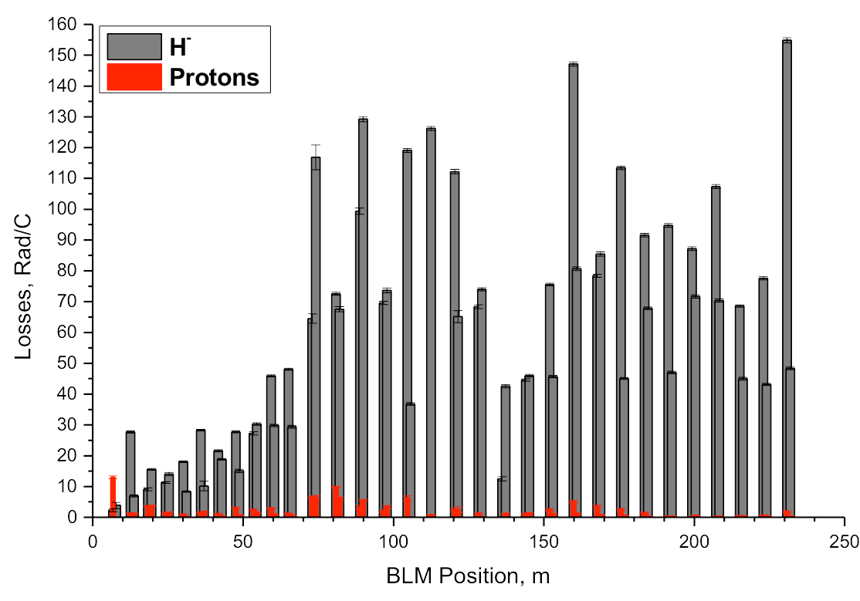
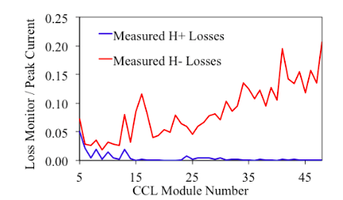
Intra beam stripping (cont.)
Observations consistent with IBSt, simple model calculation predicts correct magnitude*
Best proof is to accelerate protons instead of H⁻
• Result: Proton losses are ~20x less than H⁻ losses (but not zero)
Measured at LANCE
Distance along SCL

Slide 20
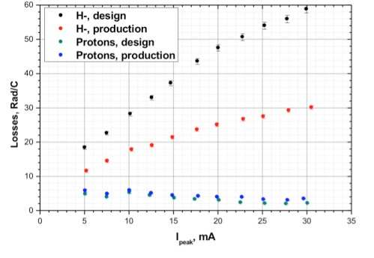
IBSt – measurement vs. calculation
We calibrated the SCL BLM system by causing known amounts of beam loss using the laser profile monitor system
Based on this calibration, and the beam loss signals during normal operation, we estimate a fractional loss of (2 – 7)x10⁻⁵ over the entire length of the SCL
A rough calculation of the expected IBSt loss is 4x10⁻⁵
Also measured beam loss for protons, and found much less loss with no intensity dependence

Slide 21
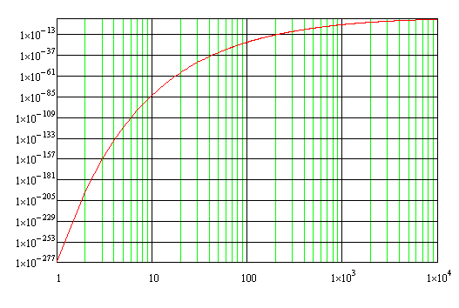
Magnetic field stripping
Lorentz-transformed magnetic field looks like electric field in rest frame of beam particles
Loosely-bound electrons on H⁻ particles can be stripped off
E_{ion} [V/m] = βγcB_{lab} [T]
Frac. loss (10⁻²⁷⁷ to 10¹¹)
EEE =
Ring
0.5 T case
df ₌ B(s) _{e}− A 2/βγcB(s)
ds A1
A1 = 2.47E-6 V sec/m
A2 = 4.49E9 V/m
B(s) = magnetic field
β, γ, c = relativistic factors
HEBT
Beam energy (1 to 10,000 MeV)
• Seen in ISIS 70 MeV transport line to ring, level of <1%
(A. Jason et al., PAC 1981, p. 2704)

Slide 22
Beam loss in H⁻ accelerators
Beam loss mechanism | SNS | J-PARC | ISIS | LANSCE
Intra-beam stripping | Yes, dominant loss in linac | Not noted as significant | Not noted as significant | Yes, significant, 75% of loss in CCL
Residual gas stripping | Yes, moderate stripping in CCL and HEBT | Yes, significant, improved by adding pumping to S-DTL and future ACS section | Yes, not significant when vacuum is good, but can be significant if there are vacuum problems | Yes, significant, 25% of loss in CCL
H⁺ capture and acceleration | Possibly, but not significant concern | Yes, was significant, cured by chicane in MEBT | Not noted as significant | Yes, significant if there is a vacuum leak in the LEBT
Field stripping | Insignificant | Insignificant | Yes, <1% in 70 MeV transport line, some hot spots | insignificant

Slide 23
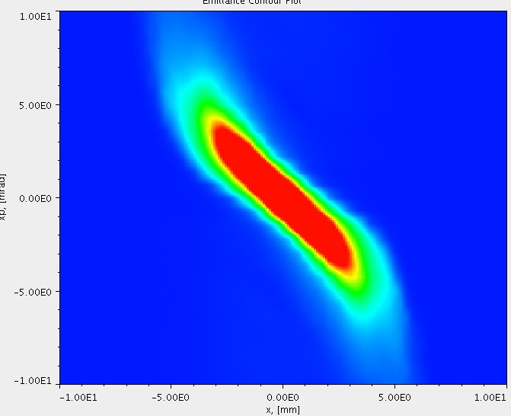
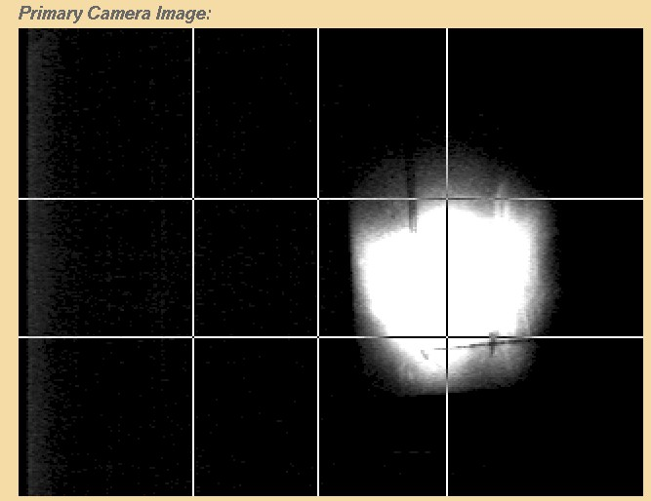
Beam loss in H⁺ and H⁻ linacs
Beam halo/tails (resonances, collective effects, mismatch, etc.)
RF and/or ion source turn on/off transients
Dark current from ion source

Slide 24
Beam loss due to RF turn on / turn off
Important for accelerators with pulsed RF systems
Beam that is accelerated while the RF fields are ramping up or ramping down is likely to be lost
Often solved with a chopper system, located at low beam energy, that blanks the beam during these times
At SNS the chopper system is not perfect, so we purposely end the RFQ RF pulses ~3 us before the rest of the RF pulses

Slide 25
Beam loss due to RF / chopping
Example at SNS: small amount of beam at end of pulse train due to poor chopping
Poorly accelerated during RF field collapse
Causes beam loss at high energy (in this case downstream of ring in transport to target)
Mitigated by turning off RFQ ~3 us early

Slide 26
Beam loss due to dark current (at SNS)
Very low (~3 uA peak) H⁻ beam current is emitted continuously by the SNS ion source due to the 13 MHz CW RF used to facilitate the plasma ignition
Dark current seen using a view screen
A portion of this beam is lost due to RF turn-on and turn-off transients, not detected by BLMs due to cavity x-ray background auto-subtraction
In early days of SNS this caused excessive end group heating in the SCL cavities
Cured by reversing phase of first DTL tank when beam is turned off, and by using the chopper to blank the head and tail of the beam for the entire duration of the linac RF pulse

Slide 27
Occasional beam loss
A large amount of beam loss can occasionally occur due to:
  Response time for RF feed back and feed forward systems
  RF trips off due to an interlock
  Fluctuations in the ion source
  Drifts in the RF system (e.g. due to temperature in klystron gallery)
  Pulsed magnets miss a pulse or provide only a partial pulse
The integrated beam power lost may be small compared to the continuous beam loss, but the consequences can be large…

Slide 28
Why occasional beam losses are important
Example: superconducting linac (SCL) cavity damage
  Beam hitting RF cavity surface desorbs gas or particulates creating an environment for arcing or low-level discharge
  RF cavity performance degrades over time
  At SNS, some cavity fields have been lowered, some cavities have been turned off
    Lower fields = lower beam energy
  At SNS, SCL cavity performance degradation from errant beam can usually be restored
    Requires cavity warm up during a long shutdown and then RF conditioning before resuming beam operation

Slide 29
Beam loss due to RF response time
RF feed back and feed forward is an important part of beam loss control. The RF system must react to and also anticipate the beam loading caused by high intensity beams.
Otherwise there will not be a constant accelerating field in the cavity for the duration of the beam pulse, which can cause beam loss
When the beam is turned back on after a trip, the RF system may have to re-optimize the feed back and feed forward parameters, and beam loss can be higher than normal during this time
Example: at SNS, after a latched beam-off trip, we slowly increase “ramp” the average beam current over a period of about 1 minute to give the RF system time to adapt, ramping both the peak current and the rep rate. Beam losses are elevated during this time.

Slide 30
Beam loss due to RF (cont.)
Also, sudden changes in the beam pulse structure can cause the beam loading to change too fast for the RF system to compensate, which can then cause beam loss
Similarly, if an RF system trips off in mid-pulse, the collapsing field in the cavity will only partially accelerate the beam, and cause beam loss in the downstream portion of the linac or beam transport lines
  Due to the response time of the MPS system (15 - 20 us at SNS) with the combined response time of the RF system (8 – 12 us), the ion source will continue to inject beam into the linac, only to be lost downstream of the affected cavity

Slide 31
Capturing the occasional beam loss events in the SNS linac
Differential Beam Current Monitor (BCM) systems
  Use BCMs in the MEBT, CCL, and HEBT to see how much beam is lost in the SCL
BLM systems
  76 ion chamber detectors along the SCL
Automated report system
  SCL BLM trip occurs, or BCM system detects abnormal signal
    Record BCM waveforms, BLM waveforms, BLM signal level
    Send data to a webserver for immediate viewing

Slide 32
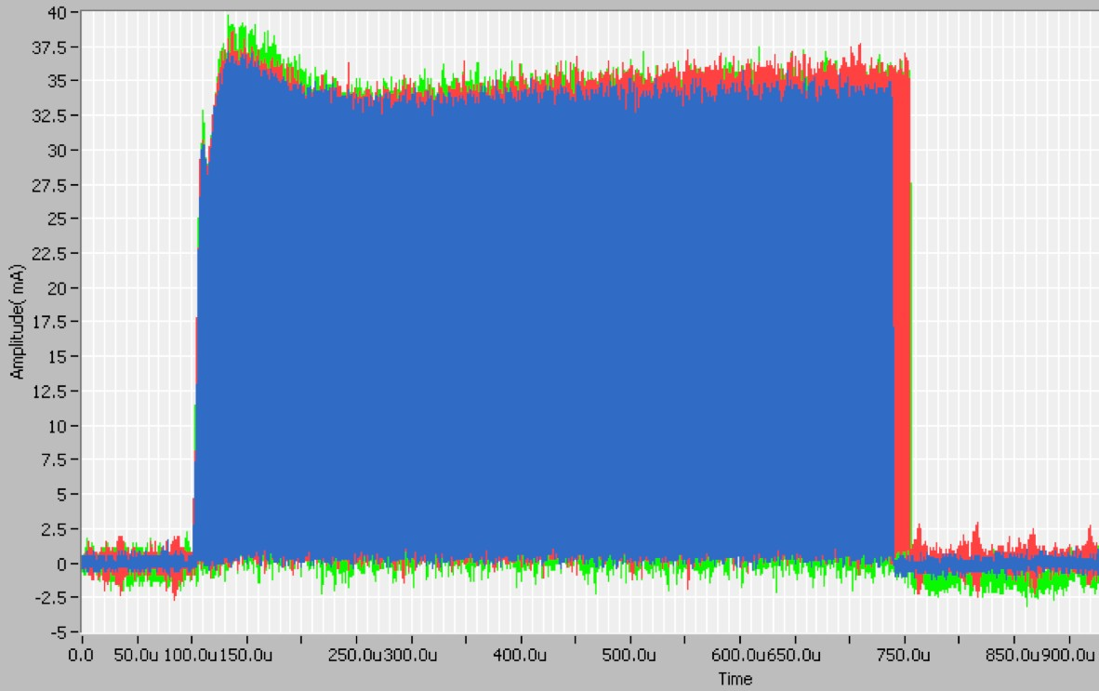






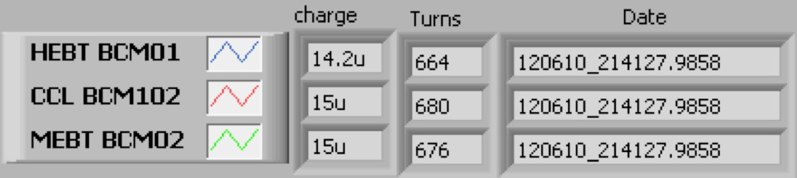
How much beam is lost?
Differential BCMs showed different types of faults
  Average 15-20 usec of beam lost in the SCL
  1 turn is ~1 usec
680 useconds in CCL
16 useconds lost in the SCL
664 useconds in HEBT
16 useconds End of DTL = 30 J End of CCL = 66 J End of SCL = 350 J
M. Plum – JIAS Nov. 2014 – Beam loss in linacs

Slide 33
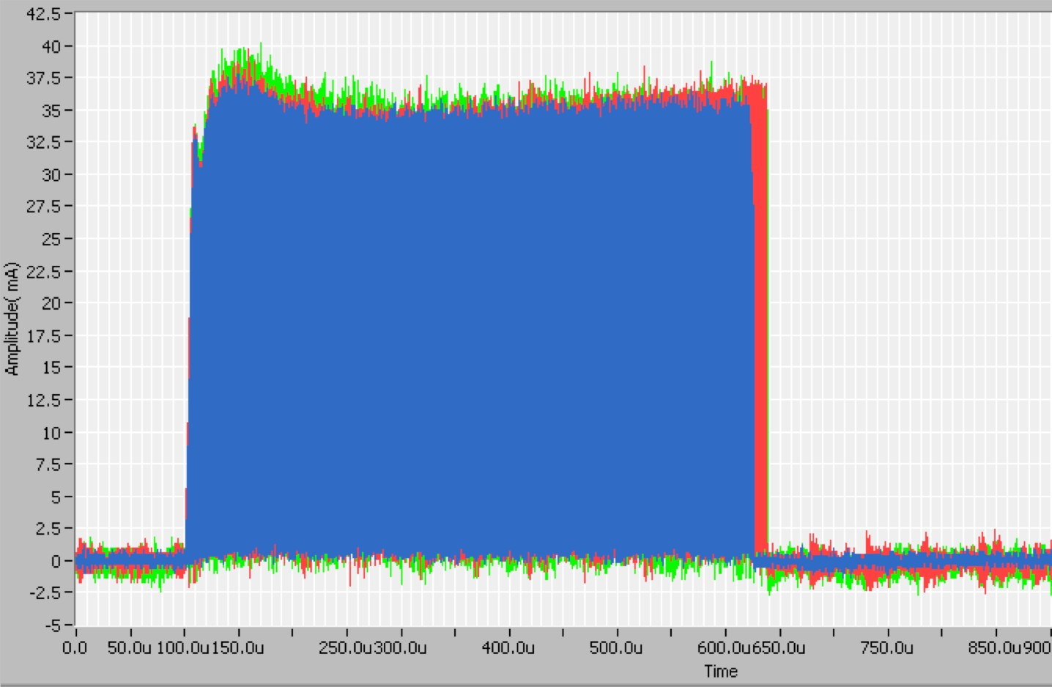


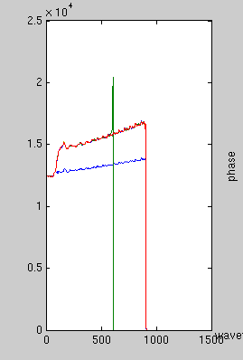







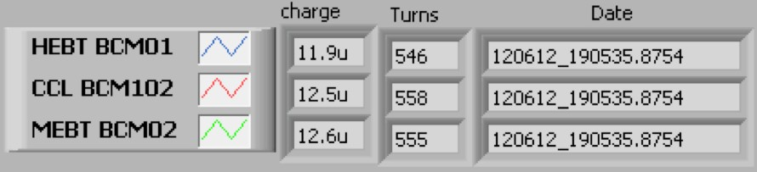
Beam loss due to warm linac RF
Abnormal RF pulse Normal RF pulse with beam with beam
LLRF output
558 useconds in CCL
Field
546 useconds in HEBT
12 useconds lost in the SCL
Time (usec)
Normal RF pulse with no beam
(Courtesy C. Peters)
34/54

Slide 34
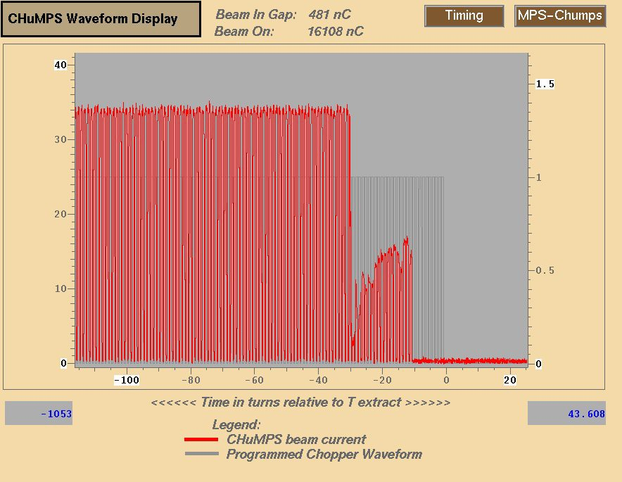
Beam loss due to ion source
Abrupt beam loss caused by sudden changes in the ion source
Fast beam current monitor in MEBT

Slide 35
At SNS, the majority of trips originate in the warm linac
< 10% of BLM trips were due to the Ion source/LEBT
  Most ion source induced BLM trips occur during the first week of a new source installation
    High voltage arcing
> 90% of BLM trips were due to Warm Linac RF faults
  RF faults occur at different times during the pulse
    Faults during the RF fill had reproducible times
    Faults during the RF flattop were random
  Focused on improving warm linac operation

Slide 36



RF fill faults can be reduced
Adjust the RF field
  Move below or above multipacting band
Adjust RF fill time
  Ramp speed through multipacting bands
Change cavity resonant frequency
  Move multipacting band
Vacuum maintenance
  Maintain low vacuum near RF window
DURING BEAM OPERATION

Slide 37
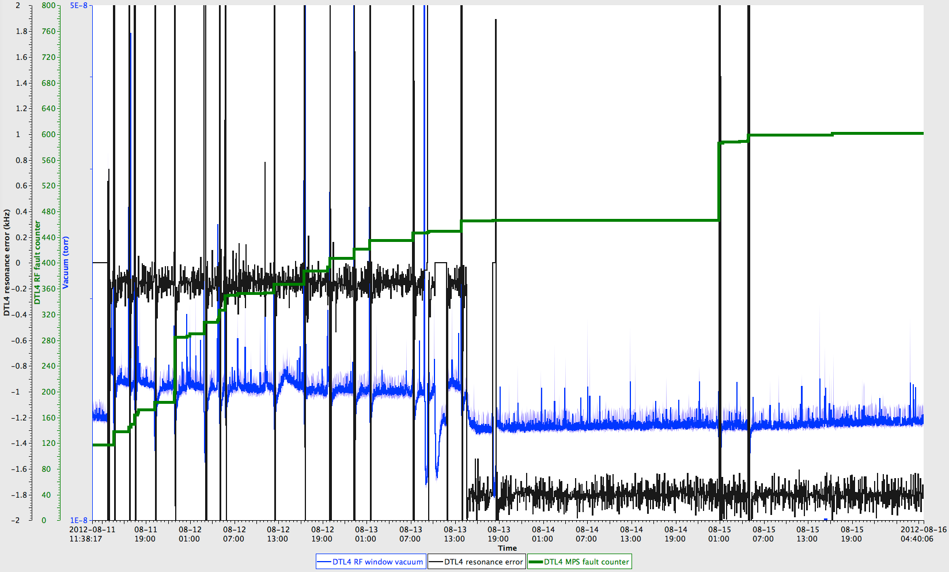




Resonant frequency change improves trip rate
Plot shows 5 days
Reduced RF faults due to vacuum
Repeated RF faults
Vacuum fault counter
Change in resonant frequency
RF window CCG
Cavity resonance error
M. Plum – JIAS Nov. 2014 –
RF window vacuum level drops
(Courtesy C. Peters)

Slide 38
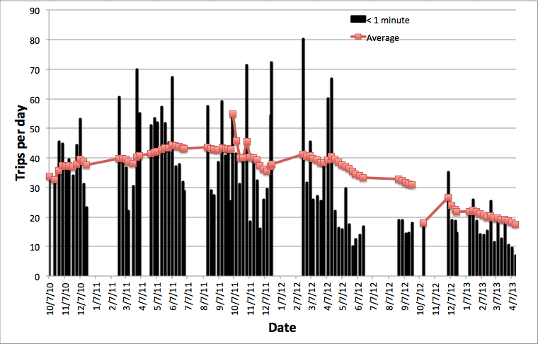
Errant beam trips reduced
From over ~40 to less than ~15 errant beam pulses per day
FY12-1
FY12-2
FY13-1
(Courtesy C. Peters)

Slide 39
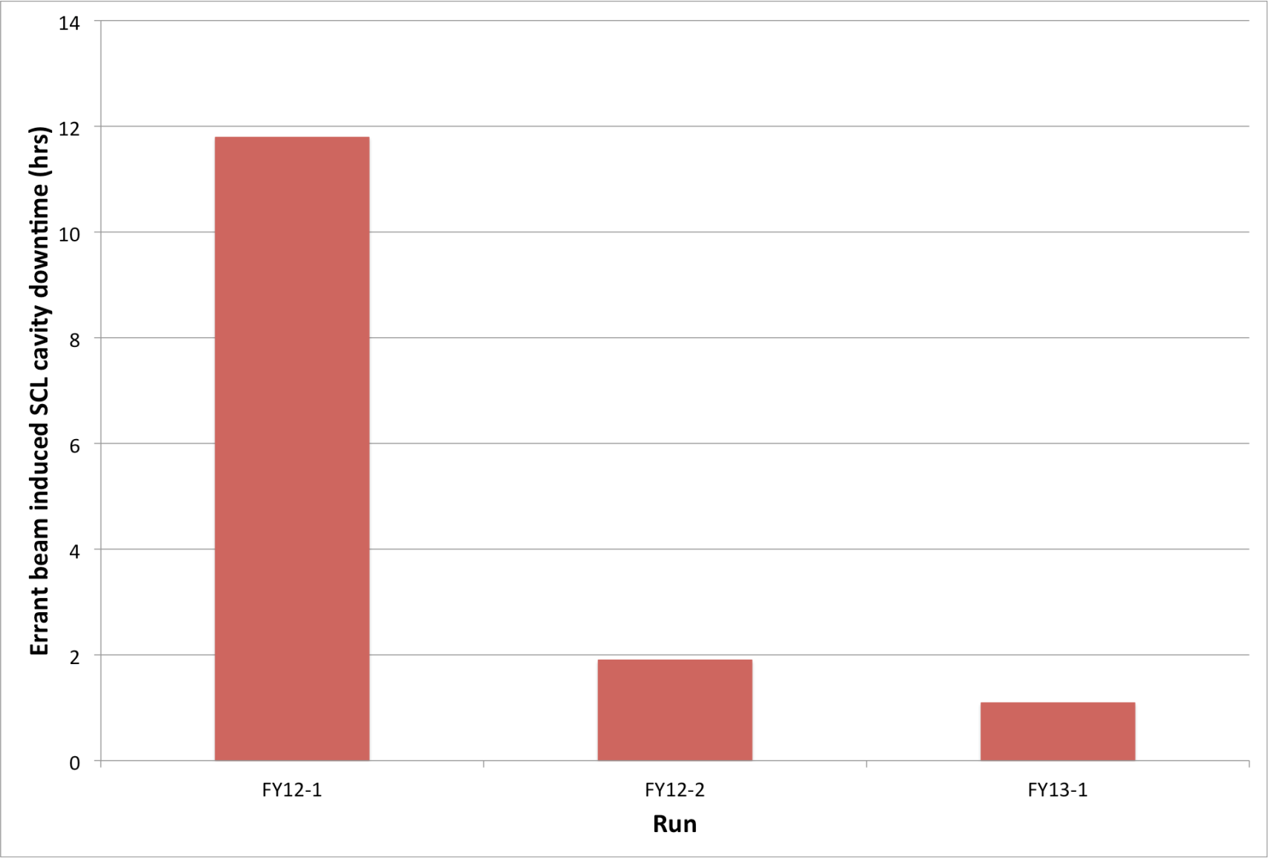


SCL cavity downtime reduced
Half of downtime was due to SCL cavity 20d.
Reducing errant beam pulses reduced errant beam induced SCL cavity downtime by factor of 3
  Lowering the gradient on problematic cavities a few percent is done during beam operation
Reduced errant beam pulses
Lowered gradients
(Courtesy C. Peters)

Slide 40
Beam loss mitigation
Cause of beam loss | Mitigation
Beam halo – both transverse and longitudinal* | Scraping, collimation, better matching from one lattice to the next, magnet and RF adjustments
Intra beam stripping* | Increase beam size (both transverse and longitudinal)
Residual gas stripping | Improve vacuum
H⁺ capture and acceleration | Improve vacuum, add chicane at low energy
Magnetic field stripping | Avoid by design
Dark current from ion source | Deflect at low energy, reverse (phase shift) RF cavity field when beam is turned off
Off-normal beams (sudden, occasional beam losses) | Turn off beam as fast as possible, track down troublesome equipment and modify to trip less often

Slide 41



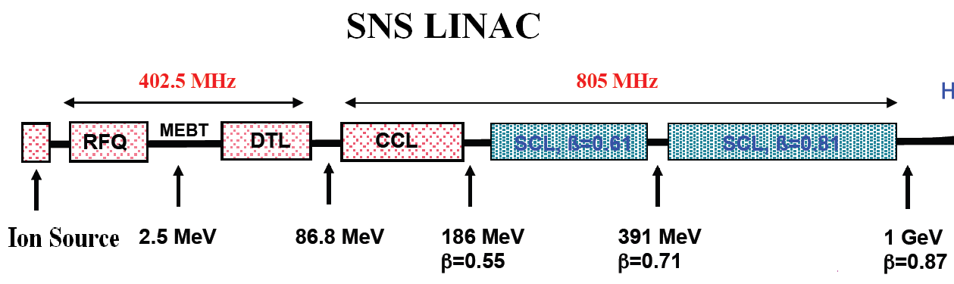

Beam loss reduction by scraping
Almost never used
In Ring:
Four scrapers
Three collimators
Most effective
Example: SNS
In MEBT:
Left-right scrapers Top-bottom scrapers
Occasionally used
In HEBT:
Two pairs of left-right scrapers Two pairs of top-bottom scrapers Two collimators
RF
Rarely used
In HEBT:
Left-right (low and high momentum) scrapers Followed by beam dump

Slide 42
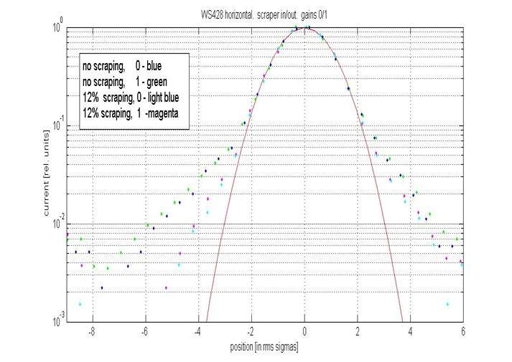


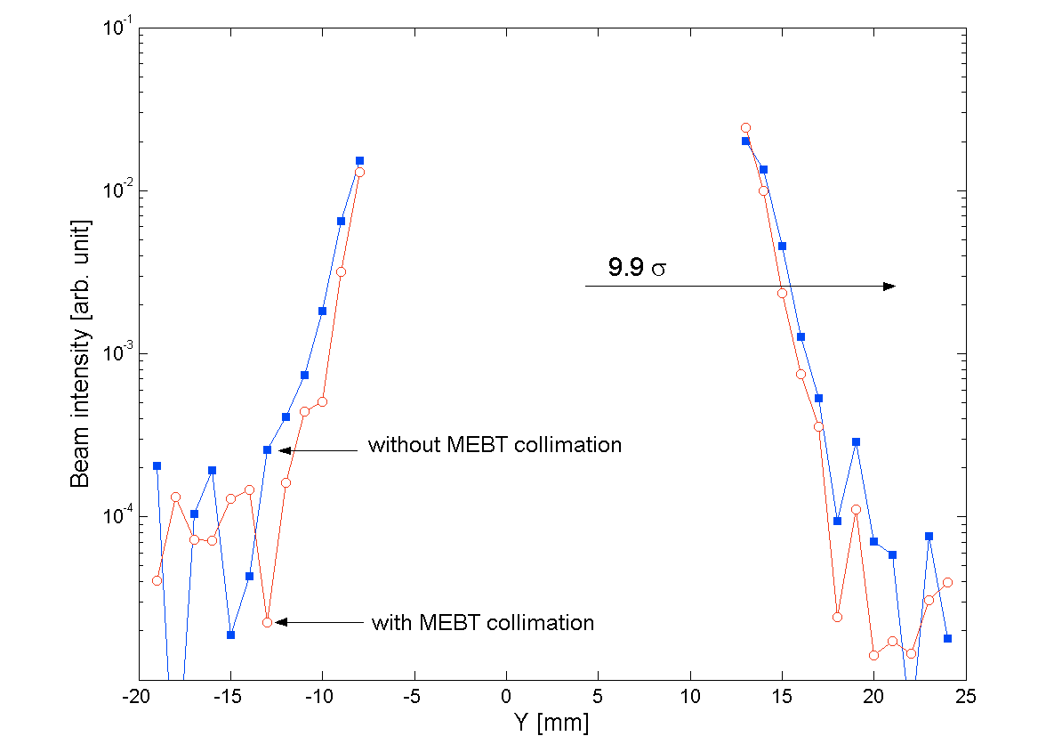
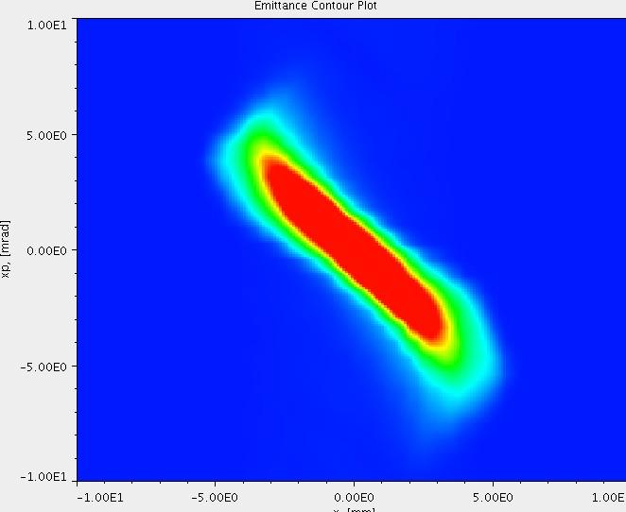
MEBT Scraping
DTL profile, log scale
2 horizontal and 2 vertical MEBT scrapers
  Standard part of production
    Reduces linac and injection dump losses by up to ~60%
    Effectiveness in loss reduction varies from source to source
No scraping
scraping
Gaussian fit
MEBT Emittance without scraping
MEBT Emittance with scraping
HEBT profile, log scale
x’ [mrad]
x’ [mrad]
x [mm]
x [mm]
(Courtesy A. Aleksandrov)

Slide 43


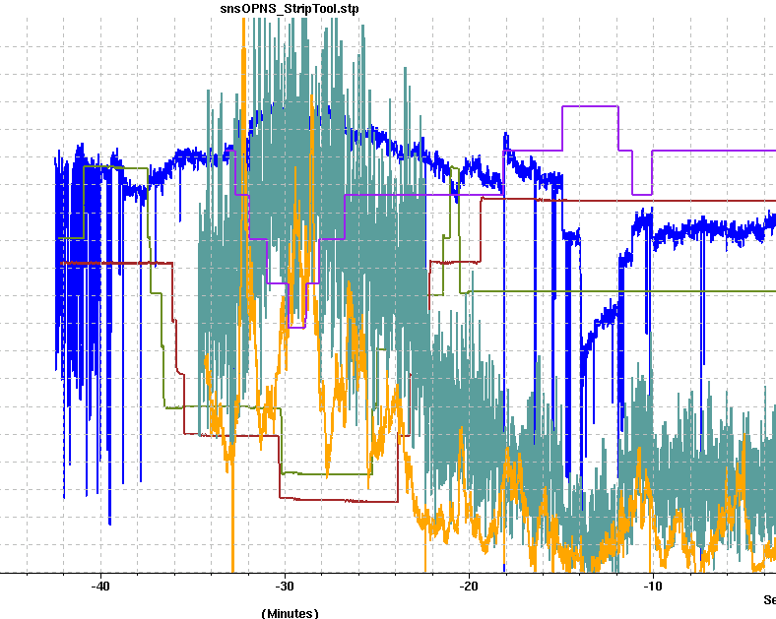



Beam loss reduction by low energy scraping
Scrapers out
Scrapers in
Beam Charge (typically scrape ~3-4% of the beam)
Warm linac beam loss (~55% lower loss at this location)
Ring Injection Dump beam loss (~60% lower loss at this location)
time
At SNS we have had good results from scraping the left/right tails of the beam in the 2.5 MeV MEBT
Up to ~60% loss reduction by scraping 3-4% of the beam
(Courtesy J. Galambos)

Slide 44
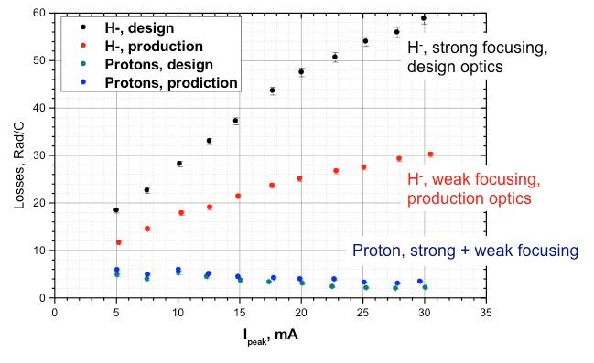

Beam loss reduction by increasing the beam size in theSNS SCL
Most of the beam loss in the SCL is due to intra-beam stripping (H⁻ + H^{− →} H⁻ + H⁰ + e)
IBSt reaction rate is proportional to (particle density)²
~50%

Slide 45
Beam loss reduction by empirically adjusting magnets and RF phase
Best beam loss is obtained by empirical tuning. This is done at all high power accelerators.
Empirical tuning sometimes results in beam that is transversely mismatched at lattice transitions (e.g. CCL to SCL, SCL to HEBT)
RF phases may also need adjustment - simulation codes may not give the best beam loss
  Example: At SNS, biggest deviation from simulations are at entrance to SCL
  One degree phase change can approximately double the beam loss at some locations
  Typical phase changes are 1 to 10 deg.

Slide 46
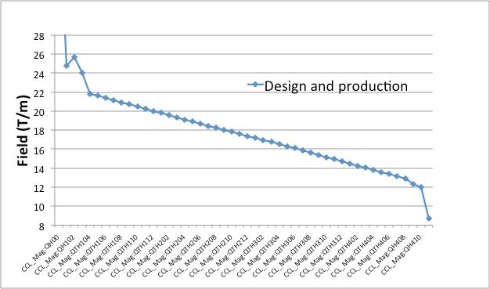
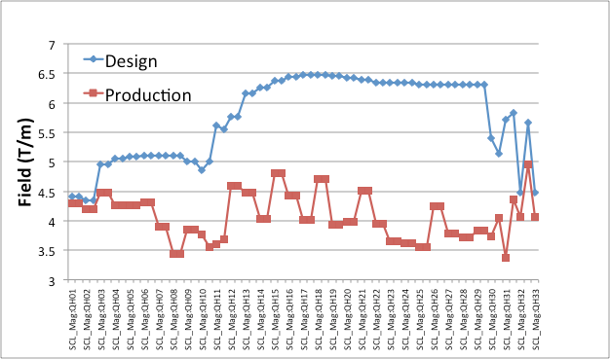
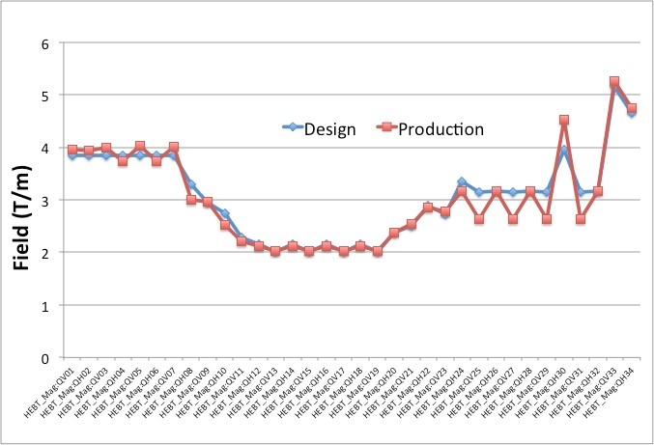
SNS Linac Transverse Lattice: Design vs. Operation
CCL
SCL
HEBT quad fields
Warm linac CCL quads are equal to design
SCL quads run much lower than design
HEBT is run close to design

Slide 47
Summary
There are many causes of beam loss. In general there are more causes of H⁻ beam loss than for H⁺ beam loss.
Two basic categories: continuous vs. occasional
Methods of mitigation vary from magnet and RF adjustments to adding vacuum pumps to adding beam line components like collimators and chicanes

